Slide 1

Week 3
Behram Khan

Slide 2
2D Games

Slide 3
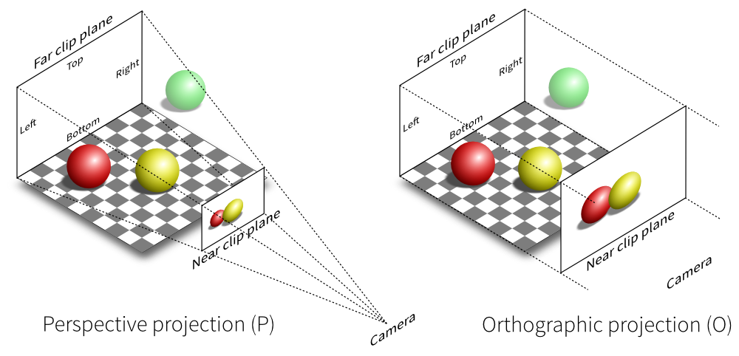
2D Game
Games that operate primarily on X and Y axis without depth.
The camera is Orthograpic
Uses sprites instead of 3D meshes
Common genres: platformer, puzzle, top-down, arcade
Notes:
STR: Store a value to memory.
ADD: Add two values.
SUB: Subtract one value from another.
MOV: Move data from one location to another.

Slide 4
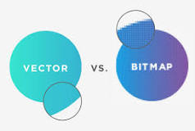
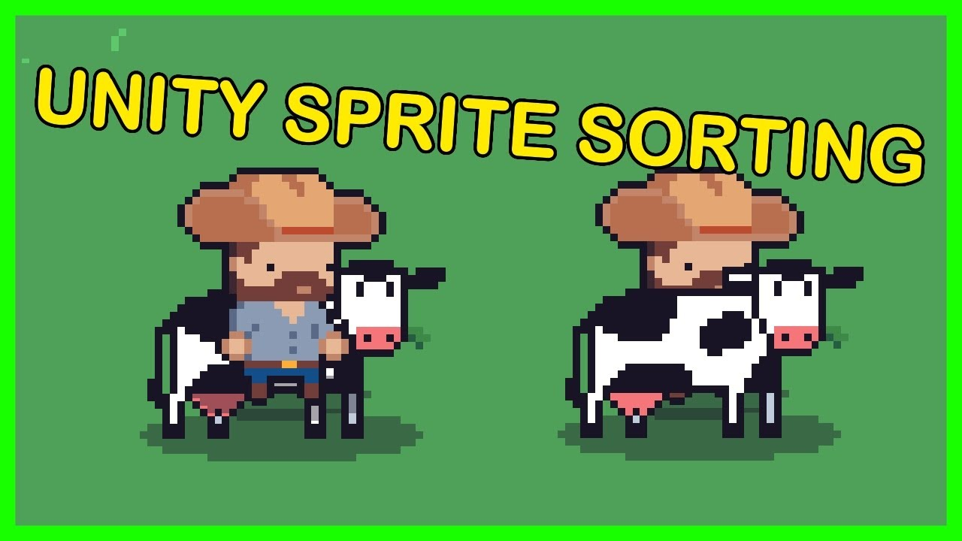

Sprites
A sprite is a 2D bitmap - image used as a visual representation of a game object.
Imported image set to Sprite (2D and UI)
Sprite Renderer component – Renders the sprites on the screen
Pixels Per Unit - How many pixels in the imported image fit into one unit of distance in the Unity scene
Sorting Layer – Sets order of rendering sprites.
Health Sprite
Notes:
STR: Store a value to memory.
ADD: Add two values.
SUB: Subtract one value from another.
MOV: Move data from one location to another.

Slide 5
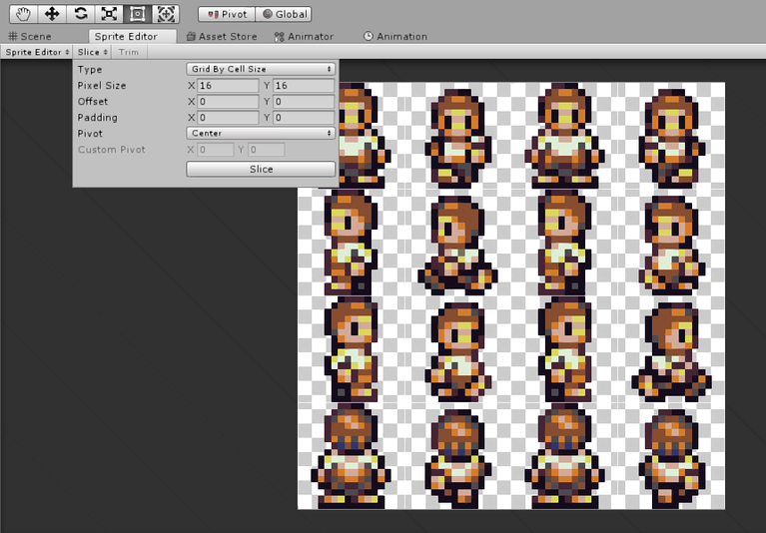
Sprite Sheets
A sprite sheet is a single image containing multiple smaller sprites.
They are sliced in Sprite Editor
Sprite Mode: Single vs Multiple
Slicing
Why use sprite sheets:
Animation
Efficient rendering
Organizing frames
Notes:
STR: Store a value to memory.
ADD: Add two values.
SUB: Subtract one value from another.
MOV: Move data from one location to another.

Slide 6

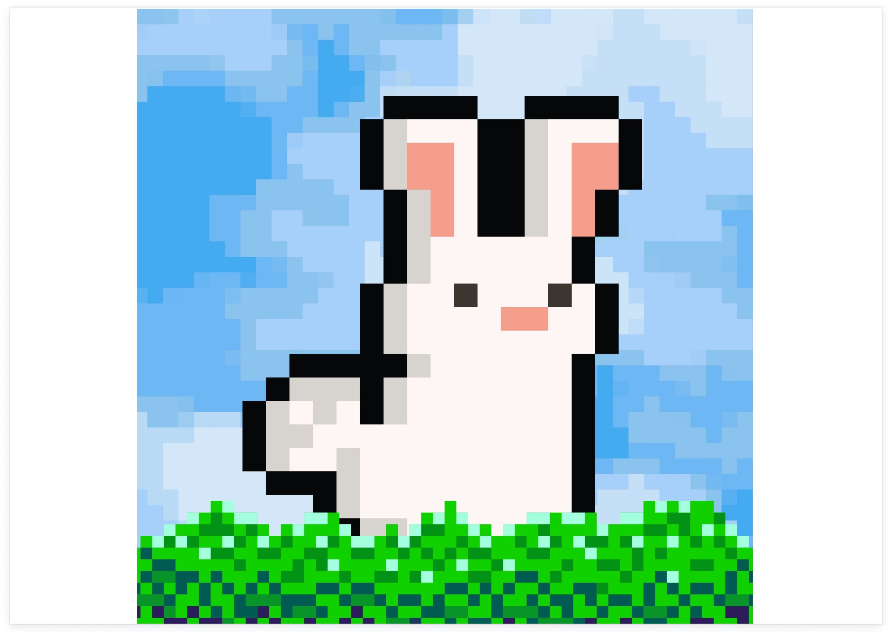
Pixel Art
Pixel art is a form of digital art where images are created and edited at the pixel level
Low resolution art style
Requires consistent Pixels Per Unit
Use point filtering (no blur)
Disable compression for sharp look
Notes:
STR: Store a value to memory.
ADD: Add two values.
SUB: Subtract one value from another.
MOV: Move data from one location to another.

Slide 7
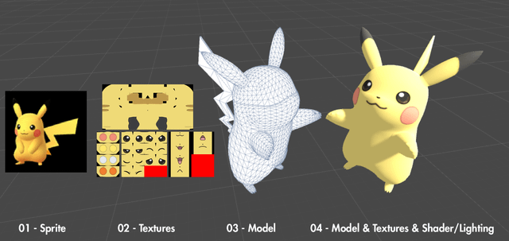
Textures vs Sprites
Both are images
Sprites are used for drawing on a 2D screen without perspective distortion.
Texture provide surface details for a 3D object that is drawn in perspective.
Texture:
Image applied to materials
Used mostly in 3D
Notes:
STR: Store a value to memory.
ADD: Add two values.
SUB: Subtract one value from another.
MOV: Move data from one location to another.

Slide 8
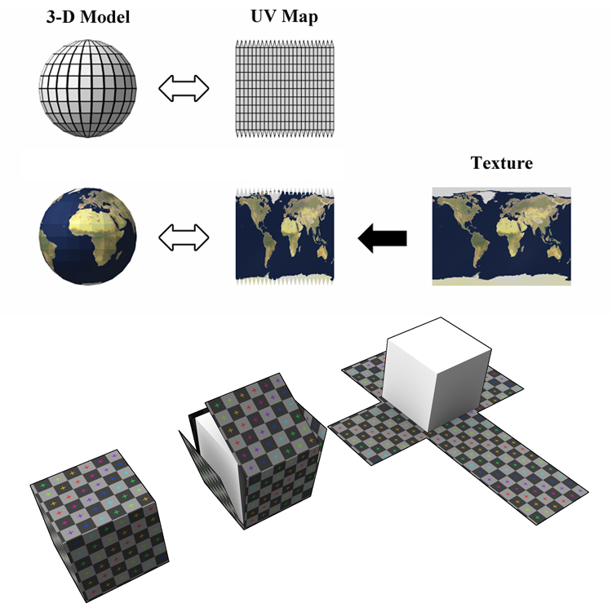
Textures vs Sprites
Notes:
STR: Store a value to memory.
ADD: Add two values.
SUB: Subtract one value from another.
MOV: Move data from one location to another.

Slide 9
2D Physics vs 3D Physics
Rigidbody2D instead of Rigidbody
BoxCollider2D instead of BoxCollider
OnCollisionEnter2D instead of OnCollisionEnter
OnTriggerEnter2D instead of OnTriggerEnter
Notes:
STR: Store a value to memory.
ADD: Add two values.
SUB: Subtract one value from another.
MOV: Move data from one location to another.

Slide 10
Decoupling Code

Slide 11
Interfaces in Unity (Decoupling)
An interface defines a contract. Any class implementing it must define its methods.
Why use interfaces:
Decoupling
Flexible communication
Reusable systems
Notes:
STR: Store a value to memory.
ADD: Add two values.
SUB: Subtract one value from another.
MOV: Move data from one location to another.

Slide 12
Interfaces in Unity (Decoupling)
We will make:
A cube that electrocutes anything it touches.
Only objects that implement IDamageable will take damage.
Player, Dog, and Police will implement IDamageable.
Pikachu will NOT implement it, so it will not take damage.
Check example and week 3 Lab for example
Notes:
STR: Store a value to memory.
ADD: Add two values.
SUB: Subtract one value from another.
MOV: Move data from one location to another.

Slide 13
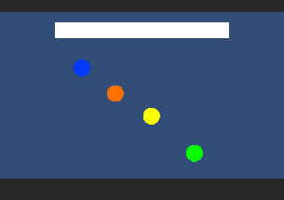





Interfaces in Unity (Decoupling)
Notes:
STR: Store a value to memory.
ADD: Add two values.
SUB: Subtract one value from another.
MOV: Move data from one location to another.

Slide 14
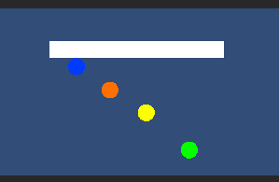

Interfaces in Unity (Decoupling)
Notes:
STR: Store a value to memory.
ADD: Add two values.
SUB: Subtract one value from another.
MOV: Move data from one location to another.

Slide 15
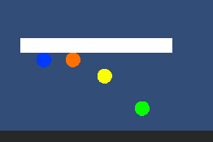
Interfaces in Unity (Decoupling)
Notes:
STR: Store a value to memory.
ADD: Add two values.
SUB: Subtract one value from another.
MOV: Move data from one location to another.

Slide 16
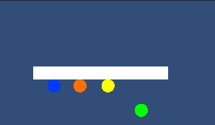

Interfaces in Unity (Decoupling)
Notes:
STR: Store a value to memory.
ADD: Add two values.
SUB: Subtract one value from another.
MOV: Move data from one location to another.

Slide 17


Interfaces in Unity (Decoupling)
Notes:
STR: Store a value to memory.
ADD: Add two values.
SUB: Subtract one value from another.
MOV: Move data from one location to another.

Slide 18
Unity Events

Slide 19
Unity Events
UnityEvents are a system for creating decoupled, inspector-configurable callbacks in the Unity engine. They allow designers and developers to trigger actions in response to certain conditions (e.g., a button click, a trigger collision) without needing direct script references between objects.
Event system in Unity
Allows methods to be triggered from Inspector
Used in UI buttons
Callback: A callback is a function passed as an argument into another function, intended to be executed ("called back") later to complete a routine or action.
https://www.youtube.com/watch?v=djW7g6Bnyrc&feature=youtu.be
Notes:
STR: Store a value to memory.
ADD: Add two values.
SUB: Subtract one value from another.
MOV: Move data from one location to another.

Slide 20
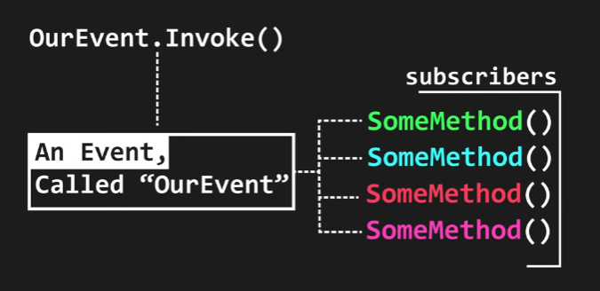
Unity Events
Notes:
STR: Store a value to memory.
ADD: Add two values.
SUB: Subtract one value from another.
MOV: Move data from one location to another.

Slide 21
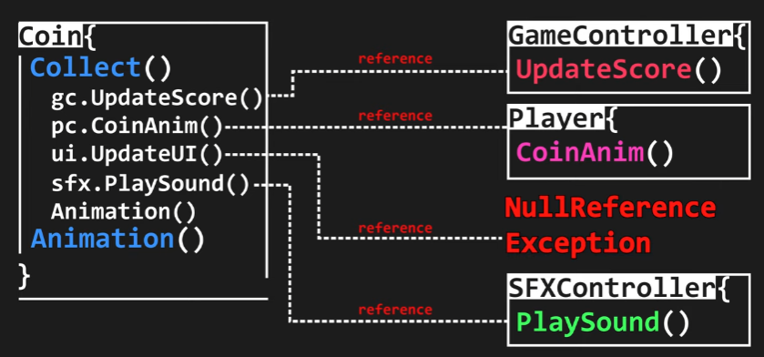
Unity Events
Notes:
STR: Store a value to memory.
ADD: Add two values.
SUB: Subtract one value from another.
MOV: Move data from one location to another.

Slide 22
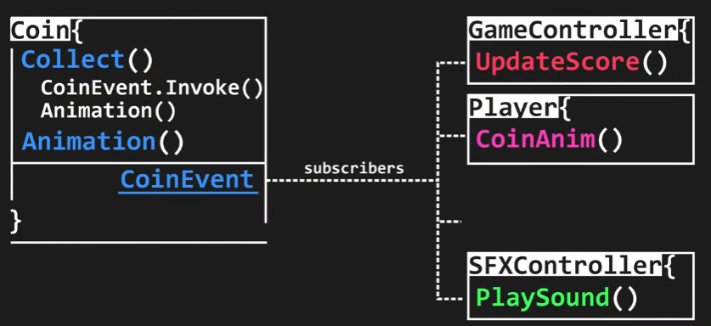
Unity Events
Notes:
STR: Store a value to memory.
ADD: Add two values.
SUB: Subtract one value from another.
MOV: Move data from one location to another.

Slide 23
Unity UI

Slide 24
Unity UI System Overview
Unity’s UI system allows us to create menus, score displays, health bars, buttons, game over screens, and more. All UI elements must be inside a Canvas. Without a Canvas, UI will not appear in the game.
Components:
Canvas
Panel
Text / TextMeshPro
Button
Image
Properties
Screen space overlay
Anchors
RectTransform
Notes:
STR: Store a value to memory.
ADD: Add two values.
SUB: Subtract one value from another.
MOV: Move data from one location to another.

Slide 25
Canvas
Canvas is the parent container for all UI elements. Every UI element like Text, Button, Image, or Panel must be a child of a Canvas.
It tells Unity that these elements are part of the UI.
It controls how UI is rendered on the screen.
It manages scaling for different screen sizes.
Notes:
STR: Store a value to memory.
ADD: Add two values.
SUB: Subtract one value from another.
MOV: Move data from one location to another.

Slide 26
Render Modes
Screen Space – Overlay
This is the most common mode. UI is drawn directly on the screen. It appears on top of everything. It does not need a camera reference. UI that doesn’t get affected by In-game movement and effects.
Use this for:
Score, Health bar, Menus
Screen Space – Camera
UI is rendered using a specific camera. It behaves slightly like world space but still UI. It's placed inside the world at a distance from the camera. Gets affected by In-game effects.
World Space
UI behaves like a 3D object in the scene. Can be placed in the world (like floating health bar above enemy).
Notes:
STR: Store a value to memory.
ADD: Add two values.
SUB: Subtract one value from another.
MOV: Move data from one location to another.

Slide 27
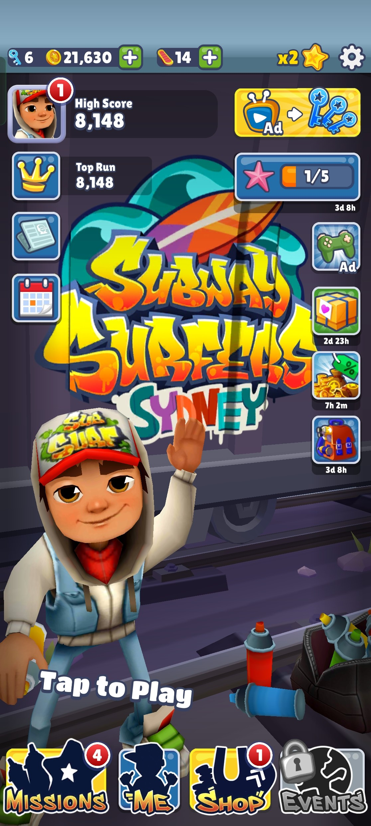
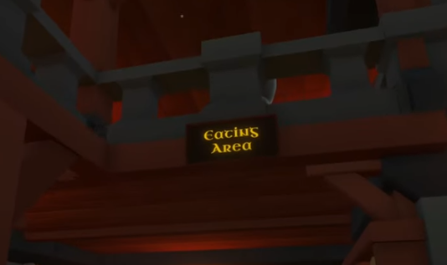
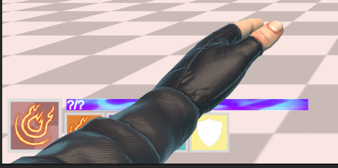
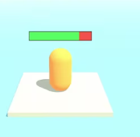
Render Modes
Notes:
STR: Store a value to memory.
ADD: Add two values.
SUB: Subtract one value from another.
MOV: Move data from one location to another.

Slide 28
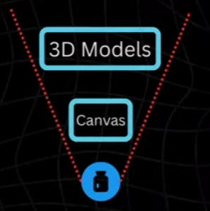
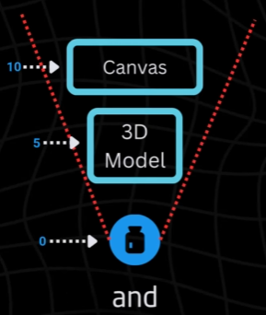
Render Modes
Notes:
STR: Store a value to memory.
ADD: Add two values.
SUB: Subtract one value from another.
MOV: Move data from one location to another.

Slide 29
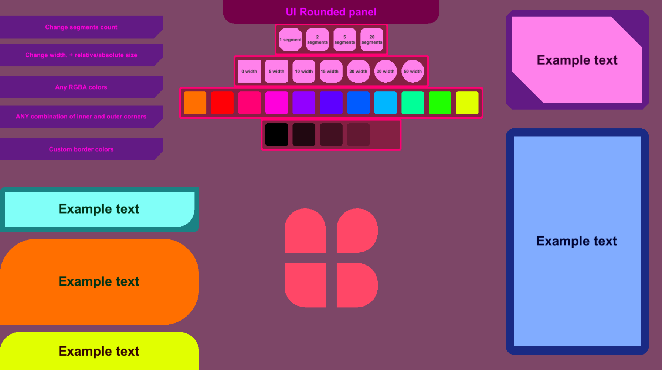
Panel
A Panel is a UI container used to group other UI elements.
It is basically an Image with a background color, used as a section.
To group UI elements together.
To create menus.
To create backgrounds for UI.
To organize layout.
Example:
Game Over screen:
PanelText (Game Over)
Button (Restart)
Text (Score)
Notes:
STR: Store a value to memory.
ADD: Add two values.
SUB: Subtract one value from another.
MOV: Move data from one location to another.

Slide 30
Text / TextMeshPro
Text
The old default text system. Simple but limited.
TextMeshPro (TMP)
Recommended by Unity. Better quality and more features.
Sharper text.
Better control over fonts.
Supports outlines, shadows, rich text.
More professional look.
Script
using TMPro;
public TextMeshProUGUI scoreText;
scoreText.text = "Score: " + score;
Notes:
STR: Store a value to memory.
ADD: Add two values.
SUB: Subtract one value from another.
MOV: Move data from one location to another.

Slide 31
Button
A Button is an interactive UI element that allows the player to click or tap to perform an action.
Start Game
Restart
Quit
Open Settings
The Button has:
Image component (background)
Button component (logic)
RectTransform (position and size)
Button has an OnClick() event.
Notes:
STR: Store a value to memory.
ADD: Add two values.
SUB: Subtract one value from another.
MOV: Move data from one location to another.

Slide 32
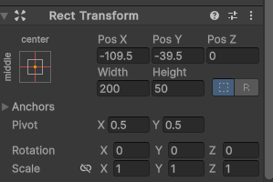
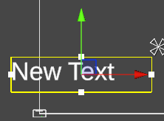
RectTransform
UI elements do NOT use normal Transform. They use RectTransform.
Unity uses RectTransform to manage position and size relative to the screen
RectTransform controls:
Position (X, Y)
Width
Height
Anchors
Pivot
Notes:
STR: Store a value to memory.
ADD: Add two values.
SUB: Subtract one value from another.
MOV: Move data from one location to another.

Slide 33
Anchor
Anchors define where a UI element is attached relative to its parent.
Anchors make UI responsive for different screen sizes.
If screen resolution changes: Anchors decide how the UI behaves.
Without proper anchors: UI will shift or look broken on different resolutions.
Notes:
STR: Store a value to memory.
ADD: Add two values.
SUB: Subtract one value from another.
MOV: Move data from one location to another.

